Slide 1
Default prediction model
Bene
Shinan

Slide 2
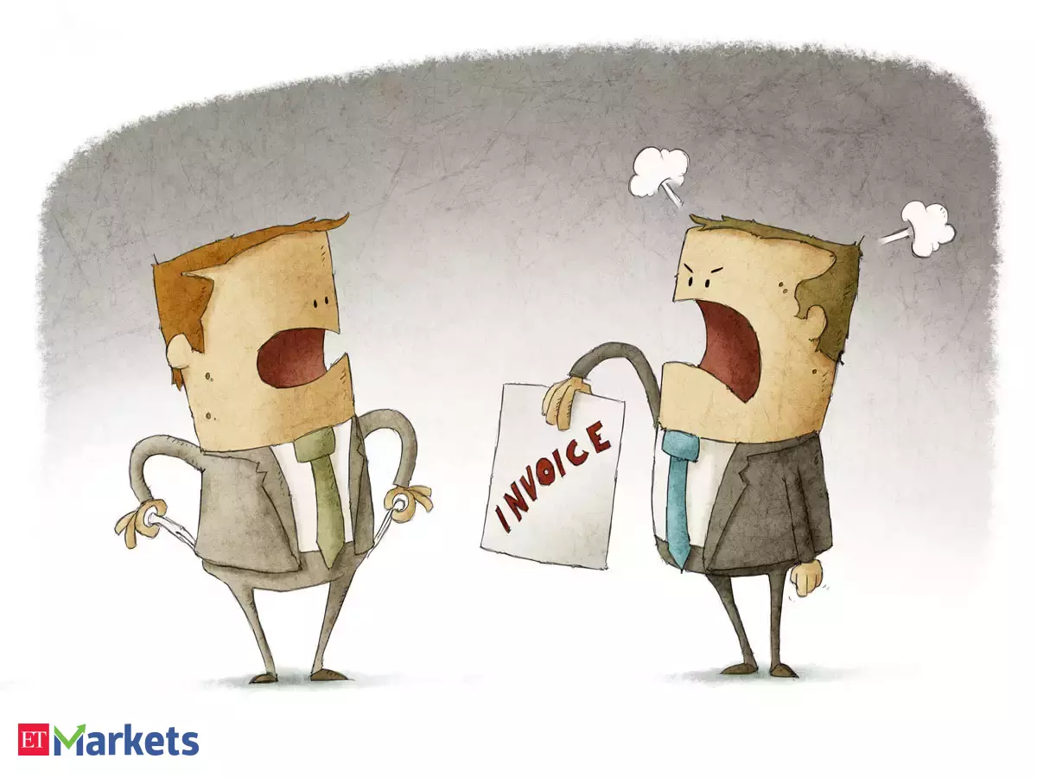
Default Risk

Slide 3

How to predict the default of a borrower? How to predict the default of a borrower?
Loan Risk Factors Dataset
Prediction
Expectations
Age | +
Income | +
Home ownership | +
Employment length | +
Loan intent | Depends
Rating | +
Loan Amount | -
Interest Rate | -
Debt to Income | -
Credit history length | +
Payment Delays | -

Slide 4
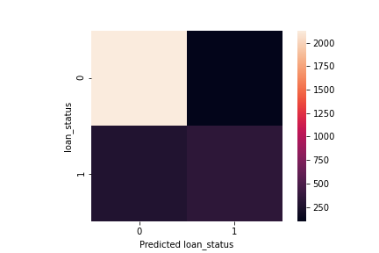
How to predict the default of a borrower? Prediction based on Logisitc Regression
TP: 96%
TN: 55%
Accuracy: 86%

Slide 5
How to predict the default of a borrower? Who will default?
 | Christina | Filipa
Age | 30 | 29
Income | 65,000 | 55,000
Home ownership | Rent | Owner
Employment length | 1 year | > 1 year
Loan intent | Venture | Home improvement
Amount | 35,000 | 15,000
Interest rate | 3.95% | 2.75%
Debt to income | 53% | 27%
Payment delays | Yes | No
Credit history length | 3 years | 1 year
Rating | B | C

Slide 6
How to predict the default of a borrower? Default Prediction
Christina & Filipa
Model
Ranking | Risk coefficients importance
1. | Loan amount | +
… | Income | (-)
Christina: Yes Filipa: No

Slide 7
How to predict the default of a borrower? Further Development
Analyze data according to demographics and adapt model
Handling imbalanced dataset (default feature)
Using machine learning approaches

Slide 8
Thank you

